Slide 1
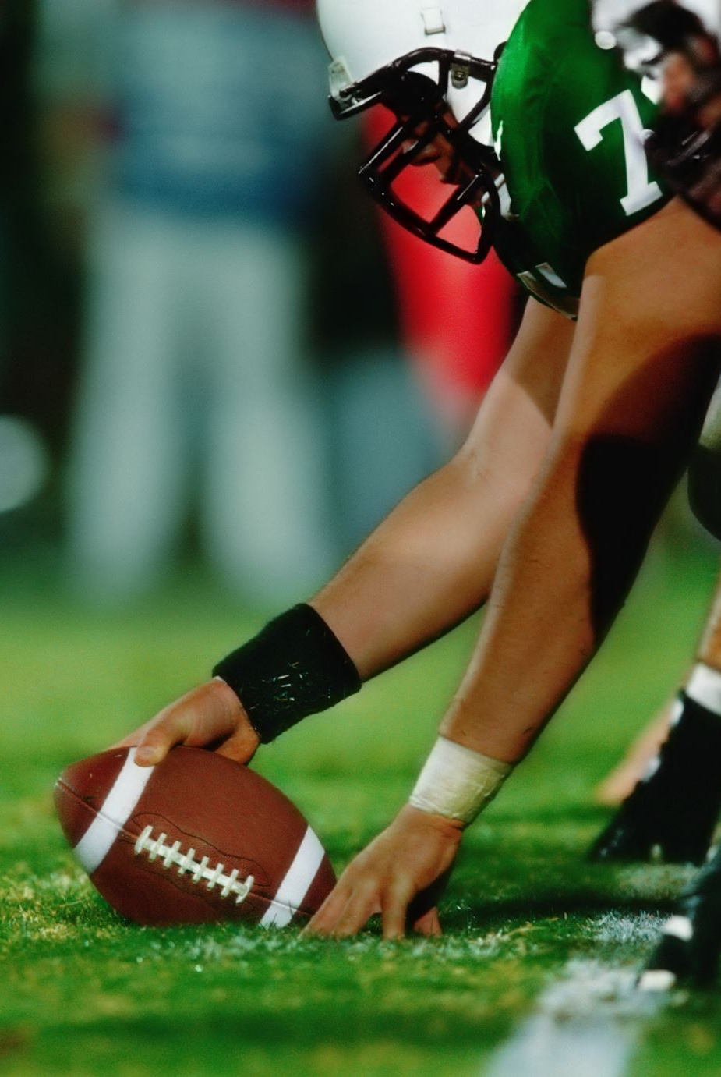
FB Mechanics Considerations, Emphasis, and Differences from CCA
KHSAA
2023

Slide 2
WHY UMPIRE POSITION IN BACKFIELD AND
WHY FOCUS ON STATEWIDE CONSISTENCY?
Always looking to provide better coverage
Fewer opportunities for missed safety fouls
Higher accuracy on Offensive/Defensive Holding

Slide 3
Basic Thoughts
All –
  For the most part, all 7-person games will use the same mechanics with no local alterations
  The CCA 2023 manual will be the guide as the starting point
  The R and U will both be in the offensive backfield as detailed.
  Where this presentation differs from the CAA manual for 2023, use the mechanics and emphasis mentioned in this presentation.

Slide 4
Scrimmage plays
Referees –
  Count players before Team A breaks the huddle or as early as possible without a huddle
  Positioned to the right of the QB at least as wide as the Tight End
  13-15 yards deep
  Guard and Tackle on the right side are your initial keys (area of responsibility) as well as backs in your vision
  Be aware of emphasis point in change in 3-6-1-b1, all officials are to be in place before it is considered to be ready and premature snap at that point is against the offense.
  Help manage the hurry-up as needed

Slide 5
Scrimmage plays
Umpires –
  Count players before Team A breaks the huddle or as early as possible without a huddle
  Positioned in offense backfield to the left of the QB at the left foot of the left tackle
  At least 12 yards deep, but not on same yard line as Referee
  Should be in advance of Referee
  Center as well Guard and Tackle on the left side are your initial keys (area of responsibility) as well as backs in your vision
  Use voice as needed, the “gain” of being in the backfield is emphasis on blocking, but may need strong voice to manage players.
  Manage “hurry-up” situations, including positional changes if absolutely necessary, but make them absolutely necessary and game timing related decisions!

Slide 6
Scrimmage plays
Wings –
  Count players if possible
  Positioned one yard outside the sideline at a minimum
  Watch for obvious movement of restricted linemen, particularly the tackle on your side
  Rule on legality of formations
    Warn zone
    Obvious Fouls

Slide 7
Scrimmage plays
Deep Wings and BJ –
  Count Team B players – Illegal substitution is a live ball foul
  Field/Side positioned 20-24 yards deep; Back Judge -23-27 yards unless the ball is inside the 30
  Watch for obvious movement of restricted linemen, particularly the tackle on your side
  High emphasis on clock awareness (crew)
    SJ – Game Clock
    BJ – Play Clock

Slide 8
Scrimmage plays – Running Play
Referees –
  Observe action behind the line and the runner to the neutral zone with a focus on the right side of the line
  If you read run to the right or up the middle, focus on the blocks at the Point of Attack
  If you read run to the left, focus on the blocks on the backside and QB
  Stick with the QB wherever they go, sideline to sideline

Slide 9
Scrimmage plays – running play
Umpires –
  Observe action at the line and threatened runners with a focus on the left side of the line
  If you read run to the left or up the middle, focus on the blocks at the Point of Attack
  If you read run to the right, focus on the blocks on the backside
  Allow the QB to pass you if they scramble to the side zone, maintain blocking focus
  Make your way to the inbounds spot after clearing dead ball responsibilities

Slide 10
Scrimmage plays – running play
Wings –
  Observe the initial action by or to the offensive player who is your key, especially if pressed
  If you read run to your side, focus on the blocks at the Point of Attack
  Determine forward progress when you have a clear view of the ball
  For plays that go away from you, clean up backside

Slide 11
Scrimmage plays – running play
Deep Wings and BJ-
  Observe the initial action by or to the offensive player who is your key, especially if pressed
  Pause, read and react. Do not bail
  Field/Side - If you read run to your side, focus on the blocks at the Point of Attack
  Field/Side – Be ready for crackback blocks
  If a one-on-one play goes out of bounds on your side, focus on the field of play
  Field/Side – Forward progress inside the two
  Field/Side - Do not get another football until you clear the dead ball responsibilities
  Back – Help with second level blocks up the middle and fouls in the area of the pile

Slide 12
Scrimmage plays – passing Play
Referees –
  Observe action behind the line with a focus on the right side of the line
  When the QB is a threat to be fouled, adjust your vision to the QB
  Be aware of the free blocking zone (at the snap) as this helps with exception for throwing the ball away to conserve yardage
  R will be the primary judge on legality of contact with the quarterback

Slide 13
Scrimmage plays – passing play
Umpires –
  Observe action behind the line with a focus on the left side of the line
  When the QB is a threat to be fouled, adjust your vision to the area around the QB
  Be aware of the free blocking zone (at the snap)
  If the quarterback leaves the pocket, maintain your vision on blocks
  U will be secondary on legality of contact with the quarterback, but if it is there, get it
  Allow the QB to pass you if they scramble to the side zone
  Make your way to the inbounds spot after clearing dead ball responsibilities on most plays

Slide 14
Scrimmage plays – passing play
Wings –
  Observe the initial action by or to the offensive player who is your key, especially if pressed
  If you read pass, your initial key has priority, but move to the tackle if your receiver is not threatened
  Limit movement at the time of the pass
  Primary for Ineligible Receive Downfield, with the weak side LOS having the best view
  For plays that go away from you, clean up backside

Slide 15
Scrimmage plays – passing play
Deep Wings and BJ-
  Observe the initial action by or to the offensive player who is your key, especially if pressed
  Pause, read and react. Do not bail
  Field/Side - If you read pass, move to zone coverage quickly (except red zone) and all eyes to the ball on a pass
  Field/Side – Forward progress inside the two
  Field/Side - Do not get another football until you clear the dead ball responsibilities
  BJ – Help with second level blocks and fouls in the area of the pile

Slide 16
Scrimmage plays – spotting the ball & pace
Referees –
  If a running play ends in your side zone, prepare to triangle the ball into the umpire
  If a running play ends in the umpire’s side zone, prepare to help spot the ball
  When the umpire has the ball in their hands, start the game clock if required
  Scan the field for flags/subs, indicate a first down when needed

Slide 17
Scrimmage plays – spotting the ball & pace
Umpires –
  Running play or completed pass in the middle third, you are responsible for retrieving the ball and spotting
  On a run or completed pass to your side zone, prepare to triangle the ball to the referee for spotting
  On a run or completed pass to the referee’s side zone, prepare to spot the ball at the inbounds spot
  Keep a similar pace for the whole game (unless under 2:00 in the 2nd/4th quarter and time is a factor)
  Our goal is to get the ball on the ground between :28 and :32
  Maybe more time needed on a long pass play, but do not put the ball down early as that is the expected pace for the remainder of the game
    If we go too fast, we make mistakes as do the players
    Going too fast can lead to injuries
  Keep the lateral position on a down indicator (1, 2, 3, 4, 5 or LH, LM, M, RM, RH)
  Place the ball on a spot that you can consistently enforce penalties from

Slide 18
Scrimmage plays – spotting the ball & pace
Wings –
  Mark forward progress – Don’t be too finite
  Officiate players, do not worry about the exact blade of grass that a spot is on
  Place the ball at your feet if the play ends in your side zone
  Pinch hard on critical spots – in the field of play if you are not sure on a TD/safety
  Ask for the ball and place it exactly when the LTG is threatened
  Officiate players, do not worry about the exact blade of grass that a spot is on

Slide 19
Scrimmage plays – spotting the ball & pace
Deep Wings and BJ-
  Accordion in when the play is over
  Field/Side - Do not get another football until you clear the dead ball responsibilities
  BJ – Help with fouls in the area of the pile
  Make sure that the R has clock status as necessary
  Make sure that clocks are correct when needed

Slide 20
Free kicks
Same initial positioning two yards off the sideline
Count players for K and R before putting the ball in play
Same coverages and mechanics as in the past
  Once the ball is kicked, U and BJ need to let K cross their face before coming onto the field
  Wings – hold your position until the GL is no longer threatened
  Zone coverage for all officials, but don’t leave a threat

Slide 21
Scrimmage kicks – punts
Referees –
  Initial position 8-10 yards wide of the ball and 3-4 yards behind the punter
  Aware of numbering exceptions to the right side
  When the punter is a threat to be fouled, adjust your vision to the punter
  Be aware of the free blocking zone (at the snap) as this is your piece of ING/RRK
  If the punter leaves the free blocking zone (at the snap), officiate inside-out
  R will be the primary judge on legality of contact with the punter

Slide 22
Scrimmage kicks – punts
Umpires –
  Normal Initial position normal TE position and 3-4 yards behind the punter.
  NOTE: On obvious kicking downs (long to go, etc.), U may move to position in defensive backfield, 10 yards off LOS, cover blocking and pivot to cover return
  Aware of numbering exceptions to the left side
  When the punter is a threat to be fouled, adjust your vision to the area around the punter
  Primary for leaping the shield
  View the second wave blocks as K progresses downfield

Slide 23
Scrimmage kicks – punts
Wings –
  Observe the initial action by or to the K players in your area of responsibility, especially if pressed
  Legality of formation/FST
  Wait for the ball to be kicked before vacating the line
  View the second wave blocks as K progresses downfield
  Get a new ball after clearing your dead ball responsibilities

Slide 24
Scrimmage kicks – punts
Deep Wings and BJ-
  Observe the initial action by or to the kicking team player who is your key, especially if pressed
  Line up evenly approximately 5 yards behind the deepest receiver
  Start at the goal line if it can be reasonably threatened
  Field/Side/Back – hold the dead ball spot until cleared by the U
  Help with the first wave of blocks unless you have KCI responsibilities

Slide 25
Scrimmage kicks – scoring tries (PAT/FG)
Umpires –
  Initial position alongside SJ just behind linebackers in defensive backfield, 7-10 yards off LOS, cover blocking and pivot to cover return in case of failed kick that is not otherwise dead by rule
  Aware of numbering exceptions on your side
  Primary for for illegal activity by players at the line of scrimmage attempting to block the kick
  View the second wave blocks as K progresses downfield as needed (primarily FG)

Slide 26
Scrimmage kicks – scoring tries (PAT/FG)
Deep Officials –
  SJ alongside U behind linebackers in defensive backfield, 7-10 yards off LOS, cover blocking and pivot to cover return in case of failed kick that is not otherwise dead by rule
  BJ / FJ under goal post for initial position but flexible if play breaks loose
  Aware of numbering exceptions on your side
  Secondary for illegal activity by players at the line of scrimmage attempting to block the kick
  View the second wave blocks as K progresses downfield (primarily FG)

Slide 27
GOOD LUCK!

